Slide 1
Comparative Screening Life Cycle Assessment of various Recycling Technologies for Biocomposites Waste from the Aircraft Industry
This Project has received funding from the European Union’s Horizon 2020 Research and Innovation Programme under Grant Agreement N. 886416
Špela Ferjan and Rajesh Mehta
TNO
SETAC 2022 -13th October

Slide 2
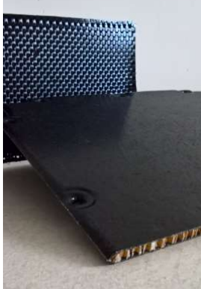
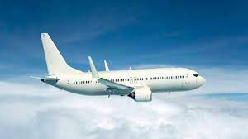
Why investigate the end-of-life of biocomposites
Aviation industry market is forecasted to grow by 5% each year. → mitigation of aviation’s environmental impact is essential.
Reduction of fuel consumption through lightweight biocomposites.
Composites presents difficulties in the waste management system:
The fiber-reinforced polymers (FRP) include polymer matrices that are usually thermosetting resins. They have a cross-linked molecular structure that poses a challenge to conventional recycling technologies.
“Aviation Market Size, Statistics | 2022 - 27 | Forecast Report.” https://www.mordorintelligence.com/industry-reports/aviation-market (October 17, 2022).
Notes:
One way to reduce emission of is by incorporating lightweight composites into the airplanes. However, composites have cross linked tehermosetting resins that is hard to recycle.
ELIOT -> Therefore in this project we are investigating the most optimal end of life path for biocomposites. We are specifically looking into biocomposites since dependency on fossils resource can be reduced and where recycling technologies have been even less researched.

Slide 3
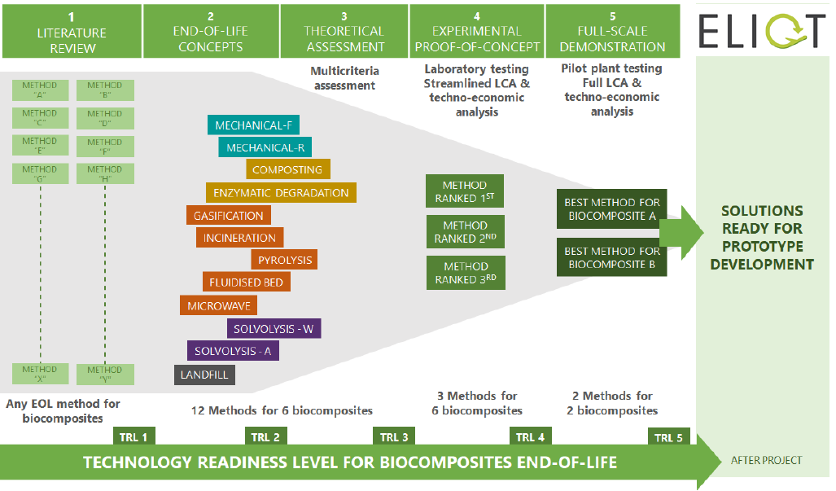
About the project
Main technical objective: full-scale demonstration of the most promising EoL methods for biocomposite waste
Definition and development of potential recovery solutions for biocomposite waste from EoL aircraft
Selection of the best EoL methods for biocomposite waste
Testing of the EoL methods for biocomposite waste at laboratory scale
Full-scale demonstration of the EoL methods for biocomposite waste
Notes:
This image gives a nice overview of the project. First a structured literature review has been conducted on the EoL methods for biocomposites, on which basis selection of 12 EoL has been made. Next a mucti criteria decision making analysis has been made, which, ranks overall performance of all bio-composites – EoL treatment options. Based upon this ranking the top three alternatives are selected for further in-depth evaluation by means of laboratory testing, techno-economic assessment and a streamlined LCA

Slide 4
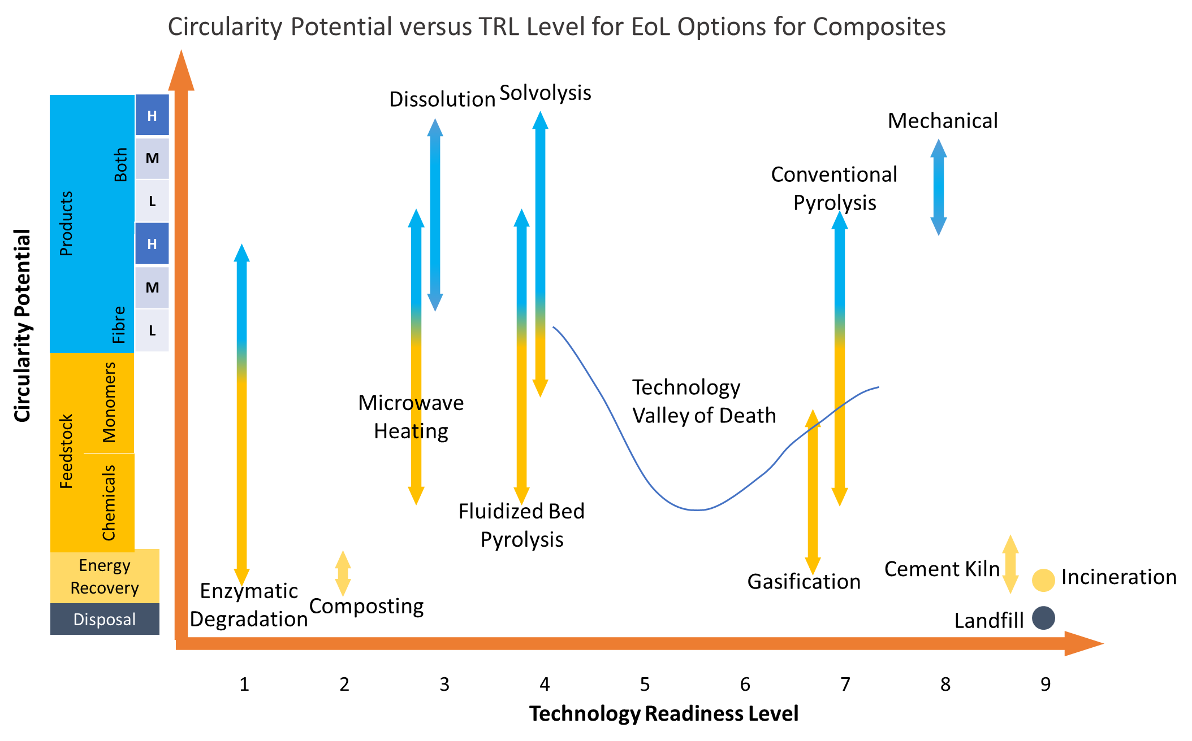
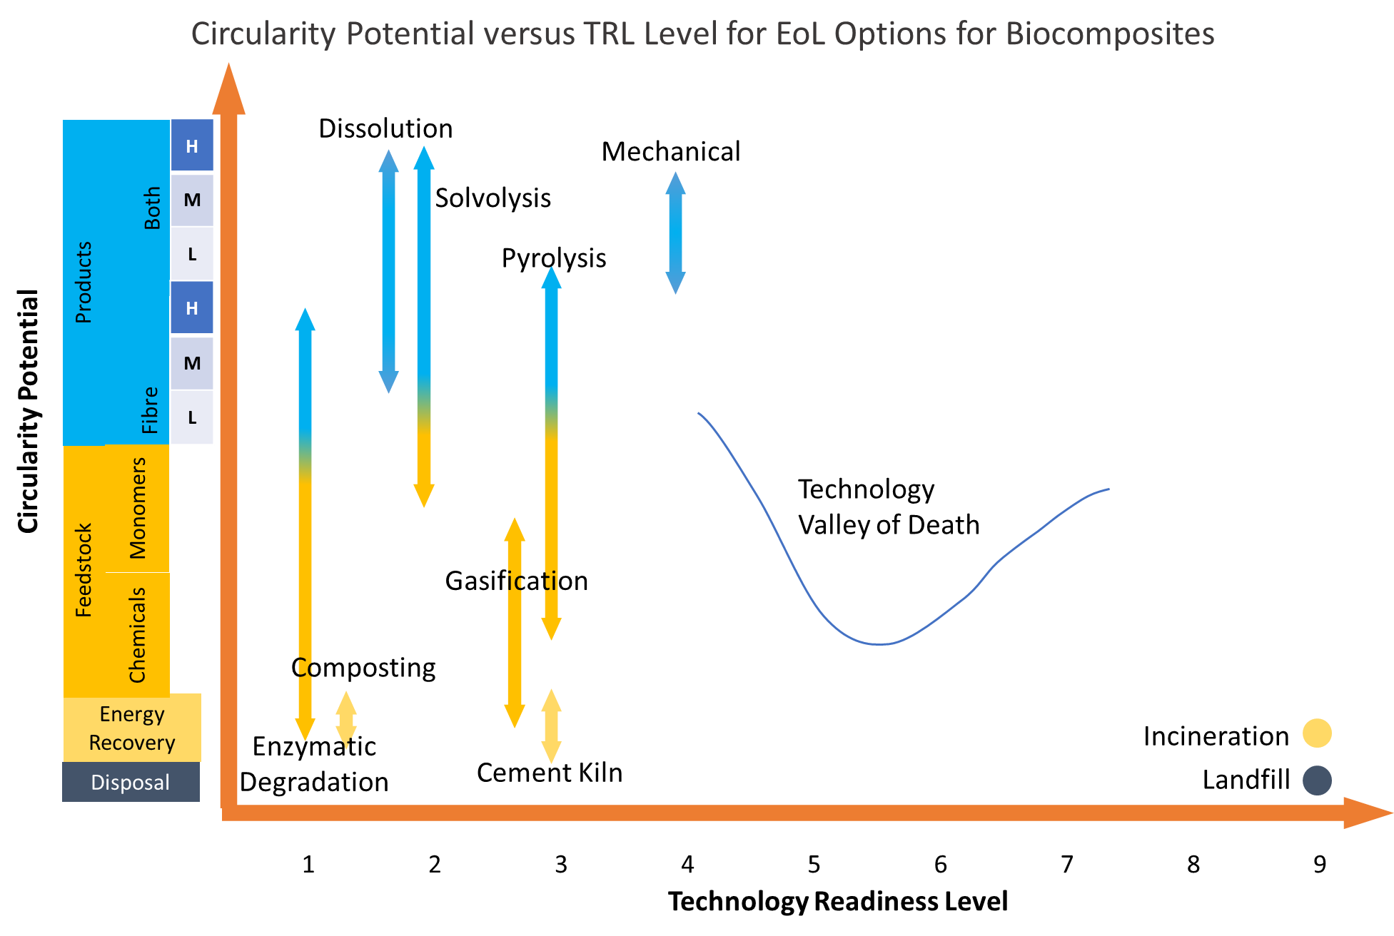
Early results
Composites
Biocomposites
Incineration and landfill out from the MCDA analysis as these are waste management options but not recycling technologies
Notes:
This slide showcases the results of WP2, where a first a attempt was made at ranking the technologies with circularity potential of EoL technologies for composites and biocomposites. The x-axis represents TRL. : Solvolysis, Dissolution, Mechanical and Pyrolysis are technologies that score well on circularity potential for composites and biocomposites. The key difference between composites and biocomposites recycling technologies is their higher level of maturity for composites. For biocomposites, almost all recycling technologies are either at lab scale or early pilot scale.
All recycling technologies for biocomposites need to face and cross ‘Technology Valley of Death’ to prove technological and commercial viability – a region where almost all technologies spend a significant amount of technology development time and most technologies die down as they fail to cross.
ELIOT!! →The main objective of ELIOT is to test and enable the technology candidates to cross the valley of death. Hence, lab test together with TEA and LCA were performed to access comparative benefits versus of the selected technologies for recycling biocomposites

Slide 5
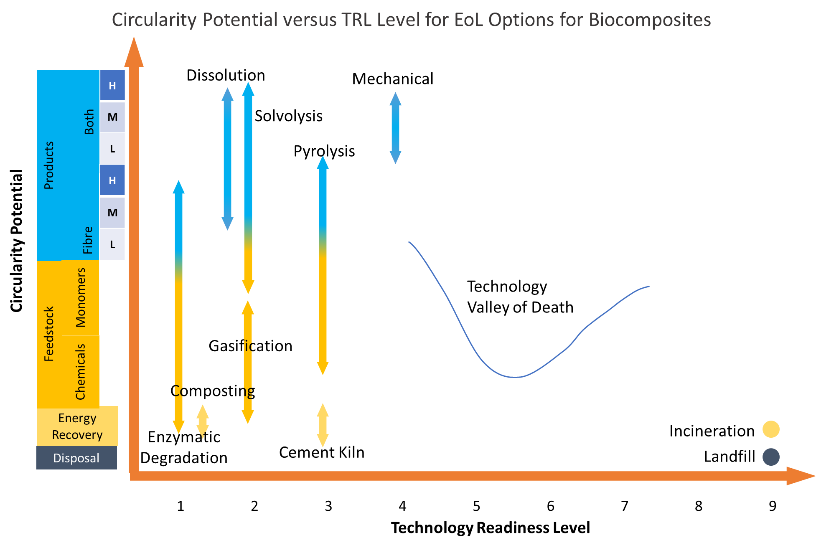
MCDA results & Circularity Potential
MCDA categories:
Technical performace;
Economical performance;
Resource performance;
Environmental performance
Notes:
Circularity potential was first attempt in ranking the technologies.
The MCDA tool was built which enables us to select the most optimal end of life methods for the 6 biocomposites. MCDA tool uses four main aspects or performance categories: Technical performance 2. Economic performance 3. Resource performance 4. Environmental performance. For each aspect, criteria is developed that determine the aggregated result per aspect.
These technologies were laboratory tested in the next stage, where it shoed that dissolution is technologically not feasible for biocomposite separation therefore LCA was done only on solvolysis pyrolysis and mechanical recycling.

Slide 6
Life Cycle Assessment
TITLE | Screening LCA various Recycling Technologies for Biocomposites Waste from the Aircraft Industry
GOAL | Quantification of the environmental impacts of three different recycling technologies for the EoL processing of targeted biocomposites
FUNCTIONAL UNIT | Managing of 1 kg of waste basalt - bioPFA composite sent for EoL treatment
SCOPE | Gate-to-gate LCA; the system boundaries are defined only around the end of the life process step of the whole life cycle
IMPACT ASSESSMENT METHOD | ReCiPe 2016 Midpoint (H)
SOFTWARE AND DATABASE | Simapro software version 9.3.03; Ecoinvent 3.8 and Industry data 2.0
ALLOCATION | System expansion
GEOGRAPHY | Europe
TECHNOLOGIES | Mechanical recycling; Pyrolysis; Solvolysis
Notes:
We took credit for avoided products.

Slide 7
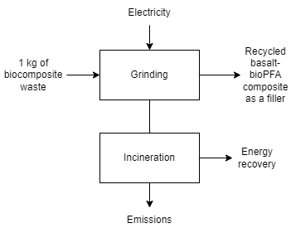
System boundaries: Mechanical recycling
Assumptions:
Composite ground to the size of particles to 5 to 10 mm.
The products of mechanical recycling replaces a filler aluminium hydroxide (ATH).
2% grinding residue assumed to be incinerated.

Slide 8
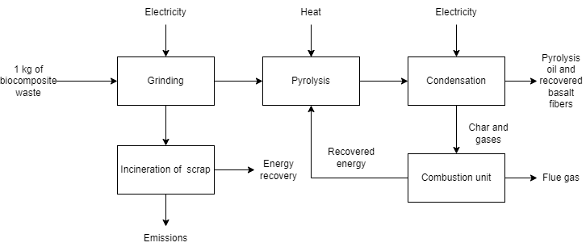
System boundaries: Pyrolysis
Pyrolysis reactor operates at 500 °C in anoxic conditions.
Product credits: Pyrolysis oil and basalt fibers

Slide 9
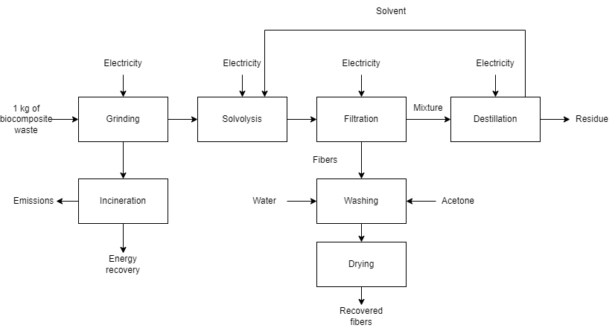
System boundaries: Solvolysis
Solvolysis conditions:
Heated to 65°C for 24 hours
Solvents: Hydrogen peroxide, water, and glacial acetic acid
Product credits: Fibers,
Residue is assumed to be incinerated.

Slide 10
Results – Carbon footprint
Pyrolysis is the best performing technology when compared to other studied technologies and for the studied biocomposites.
Pyrolysis and solvolysis technologies have higher carbon footprint but due to higher credit of the avoided products both end up relatively close in overall carbon footprint.

Slide 11
Multi-criteria Decision Analysis Results (MCDA) vs. Screening LCA
The results showed that the same group of technologies have potential for treating biocomposites, but they display different ranking.
Dissolution showed the most potential in the MCDA, due to a high recovery rate of materials but it was experimentally unfeasible. Hence, the LCA was not performed on this technology.
Pyrolysis recovers fibers and resin, whereas solvolysis recovers only fibers. That is why in screening LCA, pyrolysis performs better than solvolysis. Mechanical recycling downgrades the fibers.
MCDA | Screening LCA
1. Dissolution | 1. Pyrolysis
2. Solvolysis | 2. Mechanical recycling
3. Mechanical recycling | 3. Solvolysis
4. Pyrolysis

Slide 12
Conclusion and future work
Screening LCA shows that pyrolysis is the best performing technology compared to the studied technologies and studied biocomposites in terms of carbon footprint. It’s the only technology that recovers both fibers and resin.
Future work:
The full LCA will be conducted based on the pilot plants of solvolysis and pyrolysis technologies
Both technologies have the potential to fully recover basalt fibers.
Mechanical recycling is removed from scale-up trails at TRL 5 due to the downgrade of the fibers (economically is not profitable).

Slide 13
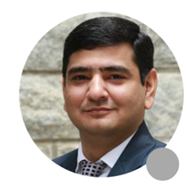
Thank you!
Špela Ferjan – TNO
LCA Expert
Rajesh Mehta – TNO
Senior Consultant

