Slide 1
END OF LIFE SOLUTIONS FOR BIOMATERIALS
JTI-CS2-2019-CFP10-AIR-03-07
Workshop 1st December 2021
Nora Lardiés Miazza
Chemical recycling area
nlardies@aimplas.es
This project has received funding from the European Union’s Horizon 2020 research and innovation programme for the Clean Sky
Joint Technology Initiative under grant agreement No 886416.
This publication reflects only the author's view and that the Commission is not responsible for any use that may be made of the information it contains.

Slide 2
Index:
The problem and the need
The solution: ELIOT project
Objectives
WPs
Results
Next steps

Slide 3
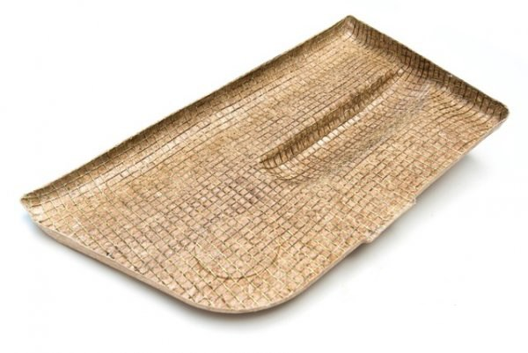
THE PROBLEM AND THE NEED
Aviation industry is working on promising technologies to mitigate the increasing environmental impact
Working on recycling the FRP parts but it is still a challenge limited now to down cycling or recovering carbon fiber
Developing new biomaterials to match the same lightness and mechanical properties of current FRP
Notes:
1) The thermosettings are difficult to recycle due to the wide variety of composite materials used in aircraft and the complexity of dealing with thermosetting resins
2) Biomaterials like flax, hemp, kenaf, etc. and thermosetting resins based on reneawable resources (biobased epoxy)

Slide 4
THE PROBLEM AND THE NEED
These new biomaterials face the same difficulties as current FRP for EoL and even more:
The technologies for their recovery have not yet been tested in depth due to the novelty of the materials
They do not contain carbon fibres (whose market value is one of the primary driving forces for FRP recycling)
URGENT NEED TO DEVELOP, TEST AND EVALUATE DIFFERENT EOL TREATMENT TECHNOLOGIES FOR BIOCOMPOSITES

Slide 5
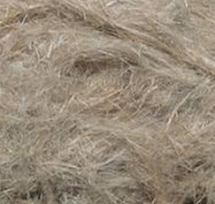
THE SOLUTION: ELIOT PROJECT
MAIN TECHNICAL OBJECTIVE: FULL SCALE DEMONSTRATION OF THE MOST PROMISING EOL METHODS FOR BIOCOMPOSITE WASTE
Definition and development of potential recovery solutions for biocomposite waste
Testing three EoL selected methods for biocomposite waste at laboratory scale
Pilot plant scale demonstration of two EoL selected methods for biocomposite waste

Slide 6
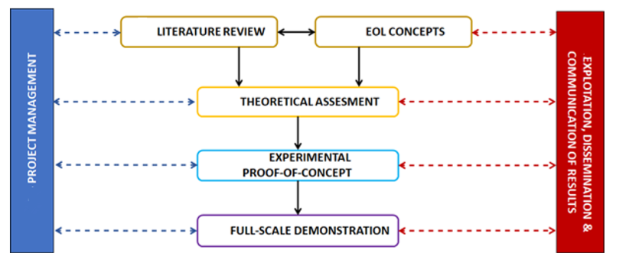
WPs
Project started: 1st July 2020
Project will finish: 1st March 2023
WP1:
WP7:
WP2:
WP3:
WP4:
WP5:
WP6:

Slide 7
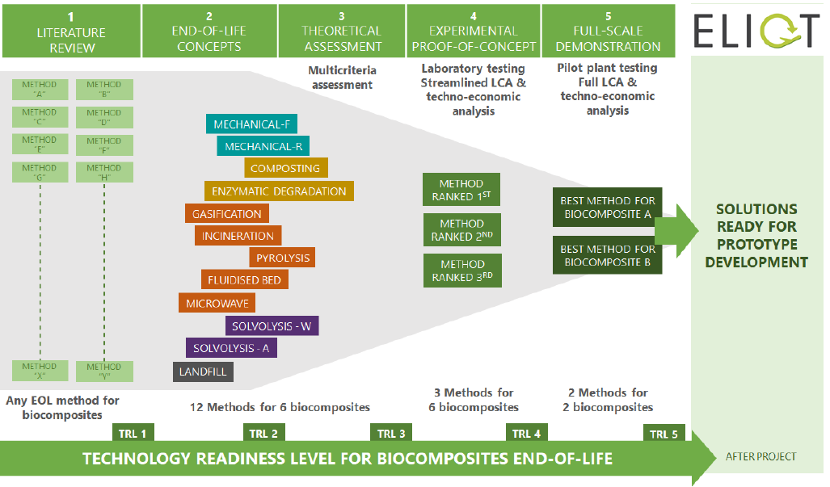
WPs
Funnel methodology followed in ELIOT

Slide 8
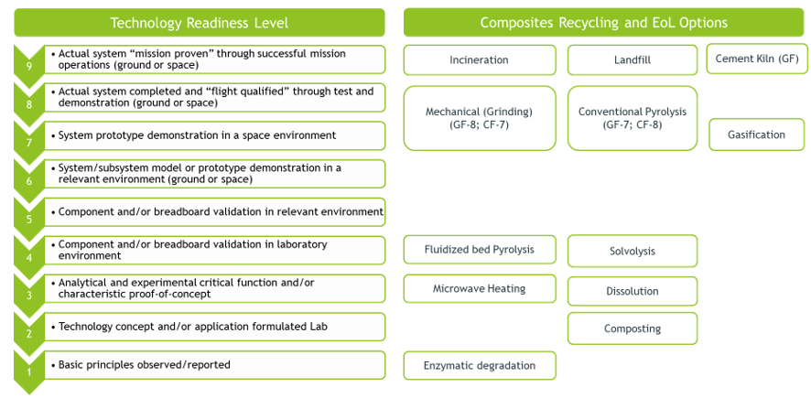
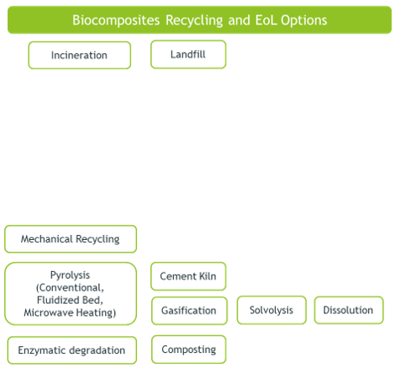
RESULTS: WP2 Literature review
TRLs of ELIOT solutions
Notes:
Based on the literature review, we prepared the TRL mapping charts to facilitate our understanding on each EoL option: first for composites, Figure 30, and later for biocomposites, Figure 31. For glass fibre and carbon fibre composites, four recycling technologies have been tested or proven at industrial scale, namely mechanical, conventional pyrolysis, gasification, and cement kiln. Out of these four technologies, mechanical recycling is simpler and easy to implement across geographies to keep supply chain distances short and manageable. Fluidized bed pyrolysis, microwave heating, solvolysis and dissolution technologies for recycling of composites are still at lab or early pilot scale. The enzymatic degradation may be an interesting option to recover expensive carbon fibres from waste CFRPs. Cement Kiln is another option for recovering GF based composites as it offers both energy and partial material recovery. But, it will not be suitable for recycling of biocomposites

Slide 9
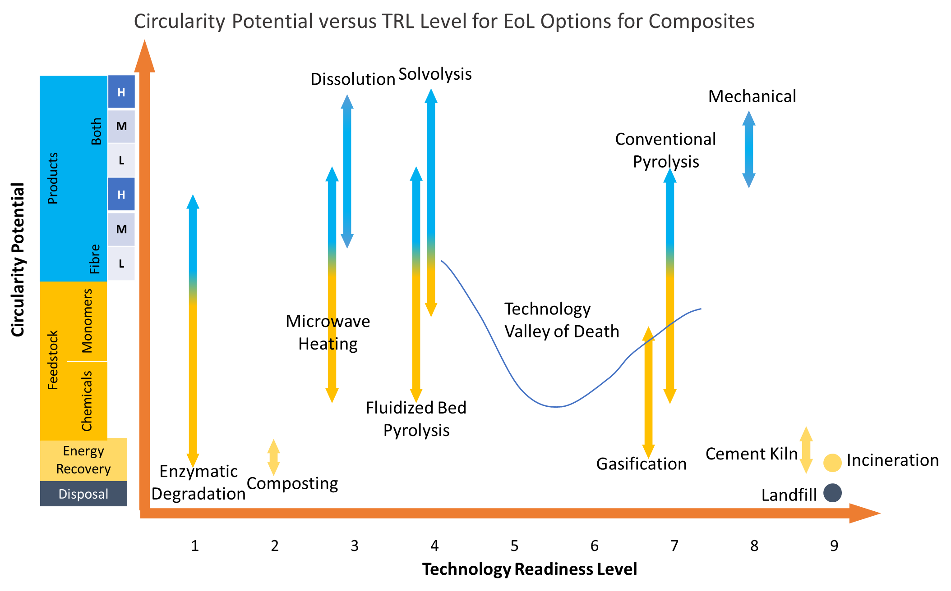
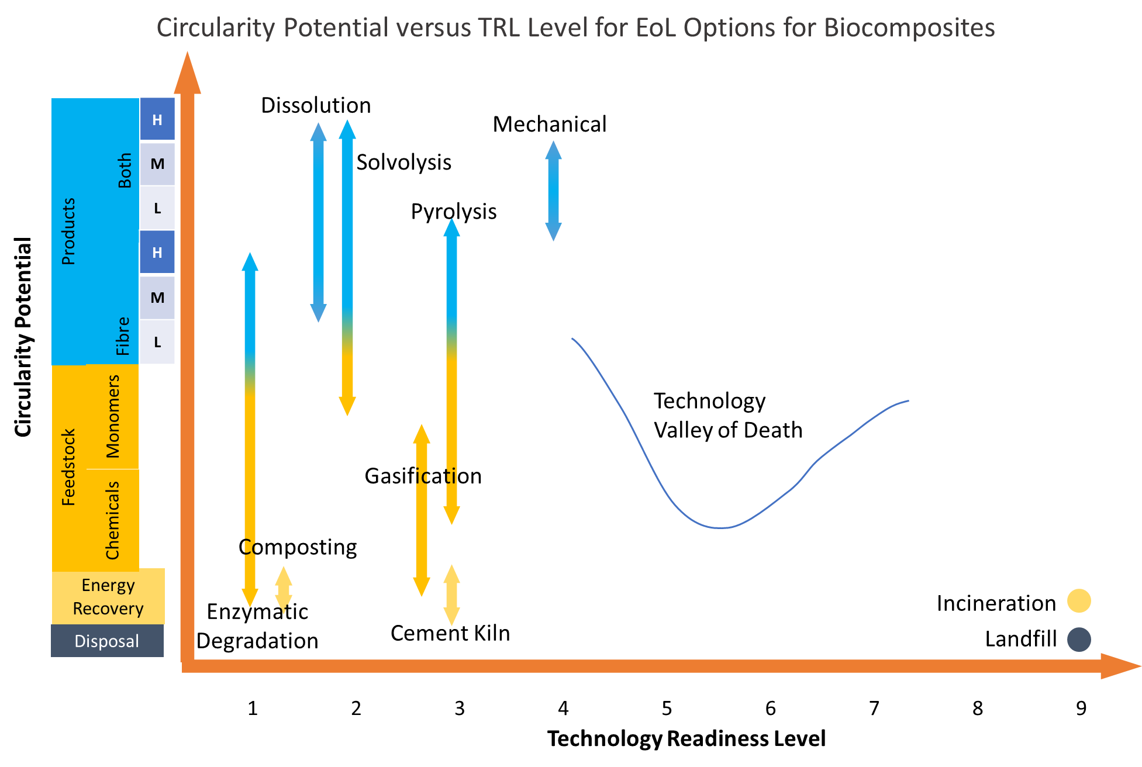
RESULTS: WP2 Literature review
Composites
Biocomposites

Slide 10
RESULTS: WP4 MCDA and ranking of EoL strategies
10 end-of-life recycling technologies were assessed following MCDA (multi-criteria decision analysis) for 2 already selected types of bio composites:
basalt fibre with bioepoxy resin
flax fibre with bioepoxy resin
A comparison of the advantages and disadvantages of each EoL methods have been conducted following a MCDA analysis:
Potential applications of the output products
SWOT analysis (strengths, weaknesses, opportunities, and threats)
Technology readiness level (TRL).
Type and form of output products recovered
Key Assessment Parameters of the MCDA analysis
Notes:
SWOT (strengths, weaknesses, opportunities, and threats) analysis

Slide 11
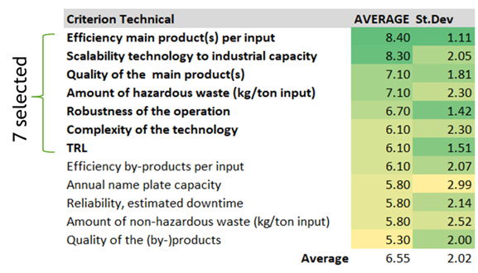
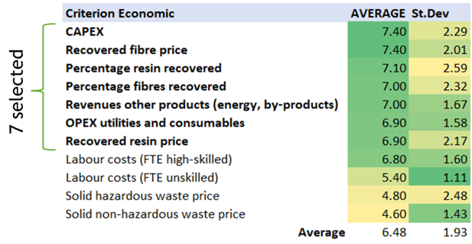
RESULTS: WP4 MCDA and ranking of EoL strategies
How MCDA (multi-criteria decision analysis) was made?
4 criterions for each EoL technology were selected: technical, economic, resources and environmental.
The criteria for each aspect together with the scaling of each criterium was proposed by the ELIOT team members:
Notes:
CAPEX: capex (contracción del inglés capital expenditure)

Slide 12
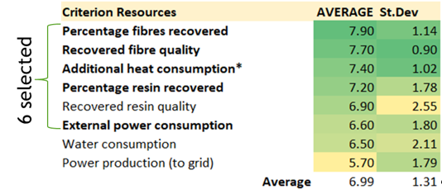
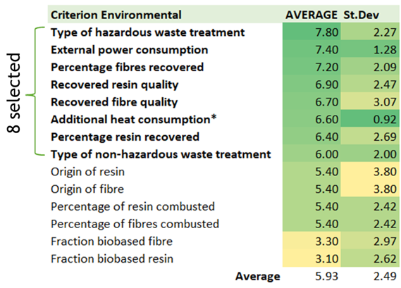
RESULTS: WP4 MCDA and ranking of EoL strategies
How MCDA (multi-criteria decision analysis) was made?
4 criterions for each EoL technology were selected: technical, economic, resources and environmental.
The criteria for each aspect together with the scaling of each criterium was proposed by the ELIOT team members:

Slide 13
RESULTS: WP4 MCDA and ranking of EoL strategies
How MCDA (multi-criteria decision analysis) was made?
4 criterions for each EoL technology were selected: technical, economic, resources and environmental.
The criteria for each aspect together with the scaling of each criterium was proposed by the ELIOT team members:
To validate the MCDA methodology, the ELIOT team conducted a consultation webinar on 17th May to present the first draft of the methodology and to seek feedback from experts for further improvements.

Slide 14
RESULTS: WP4 MCDA and ranking of EoL strategies
Once the MCDA methodology was clear:
10 end-of-life recycling technologies were assessed following this MCDA analysis for 2 already selected types of bio composites:
basalt fibre with bioepoxy resin
flax fibre with bioepoxy resin
Incineration and landfill were left out from the MCDA analysis as these are waste management options but not recycling technologies

Slide 15
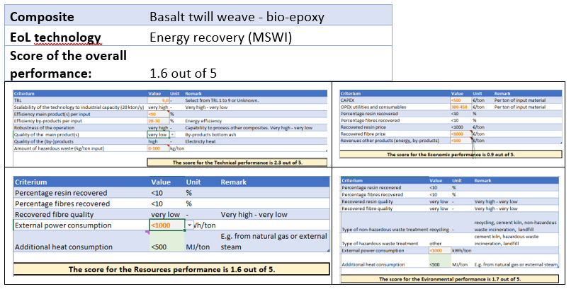
RESULTS: WP4 MCDA and ranking of EoL strategies
Example:
20 tables like this were filled
economic
technical
resources
environmental

Slide 16
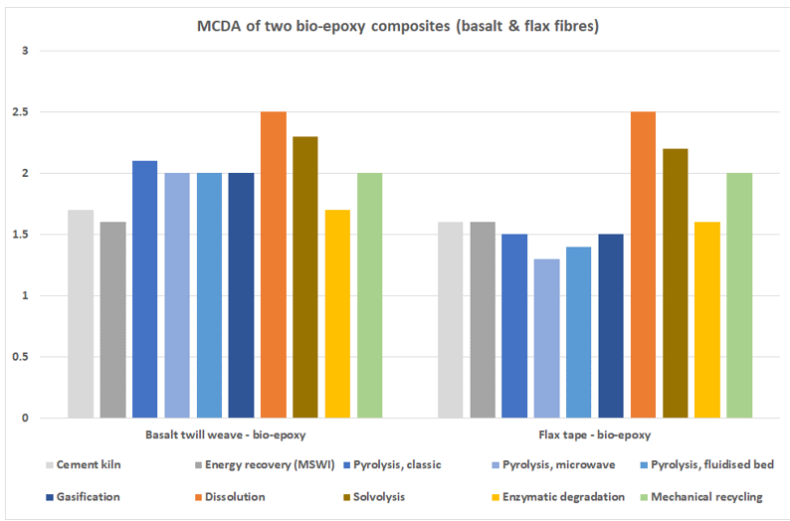
RESULTS: WP4 MCDA and ranking of EoL strategies
MCDA overall results:
dissolution
solvolysis
Classic pyrolysis
Mechanical r.
A 2nd webinar was conducted to present the MCDA results.

Slide 17
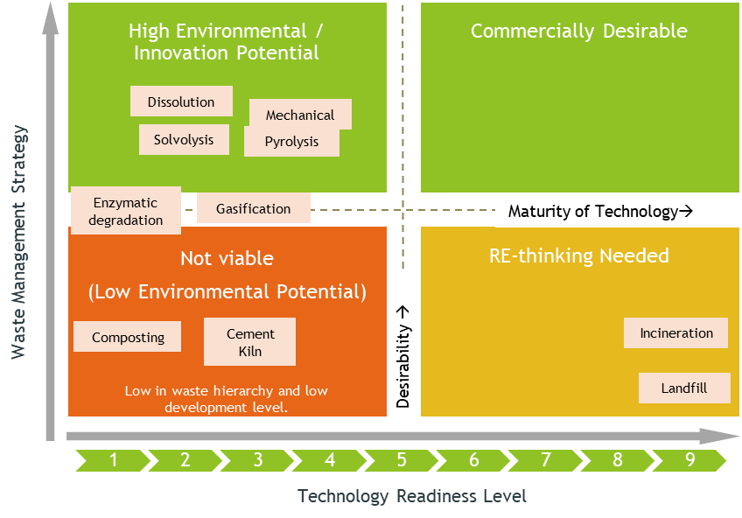
RESULTS: WP4 MCDA and ranking of EoL strategies
Technology Desirability Matrix

Slide 18
RESULTS: WP4 MCDA and ranking of EoL strategies
4 technologies ranked better on circularity potential analysis and technology desirability matrix, those EoL technologies selected were:
DISSOLUTION
SOLVOLYSIS
CLASSIC PYROLYSIS
MECHANICAL RECYCLING

Slide 19
NEXT STEPS: WP5 EXPERIMENTAL PROOF OF CONCEPT OF THE BEST CANDIDATES
The four recycling technologies selected (Dissolution, Solvolysis, Pyrolysis and Mechanical recycling) are being tested at laboratory level for the following biocomposites:
Flax fiber with bioepoxy matrix
Basalt fiber with PFA matrix
Carbon fiber with bioepoxy matrix
The test plan for experimental analysis is already finished: report of the design of experiments for each EoL method selected for experimental analysis at laboratory level.
WP6: Evaluation of full-scale demonstrator and LCA data collection.

Slide 20
Thank you for your attention!
ELIOT TEAM:
Nora Lardiés Miazza
Chemical recycling area
nlardies@aimplas.es
Sergio Fita Bravo
Project manager
sfita@aimplas.es
Mehta, R. (Rajesh)
Chemical recycling area
rajesh.mehta@tno.nl
Kessens, J.M. (Judith)
Project manager
judith.kessens@tno.nl
https://project-eliot.eu

