Slide 1
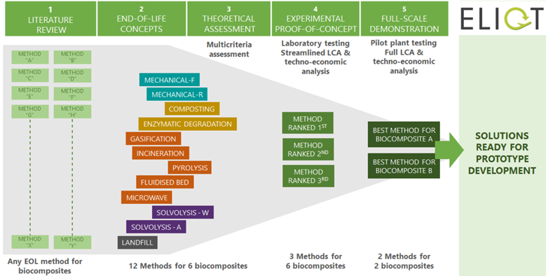
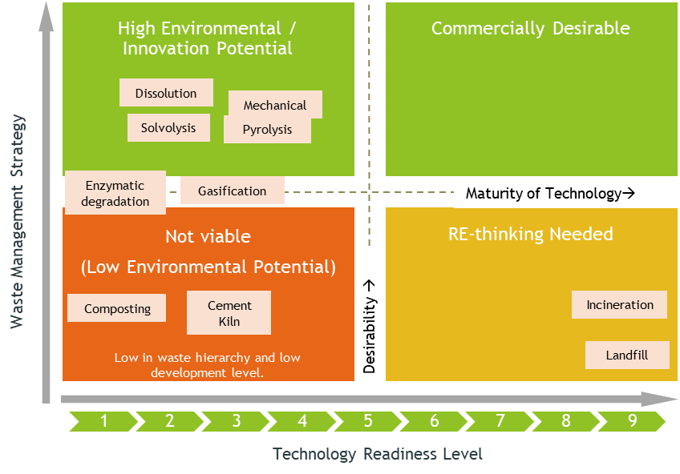
Evaluating circularity potential of various recycling technologies for biocomposites waste from the aircraft industry
Nora Lardiés Miazza¹, Spela Ferjan^{2,} Milkica Jovicic², Pouya Samani², Sergio Fita Bravo¹, Clare Harvey²
¹AIMPLAS, ²TNO
Introduction & Project Objectives
Aviation industry contributes to ~2% of human-produced CO₂ emissions. Biocomposites in the aircraft industry can provide significant environmental benefits compared to conventional materials and composites.
Issue: Non availability of technologies for recycling biocomposite waste.
ELIOT Solution:
Bridge the technology gap and develop innovative technologies at lab & pilot scale for recycling of biocomposite waste from the aircraft industry.
Perform a full-scale demonstration of two most promising recycling technologies for the biocomposite waste.
Activity (A)
ELIOT project approach
1) Conclusions of multiassesment criteria (A3) and laboratory testing (A4):
Key Assessment Parameters
Technology Desirability Matrix
Potential applications of the output products
SWOT analysis
Technology readiness level (TRL).
Type and form of output products recovered
Four technologies - Dissolution, Solvolysis, Pyrolysis and Mechanical recycling - ranked better on circularity potential analysis and technology desirability matrix.
These four recycling technologies were tried at laboratory scale in A4.
2) Conclusion of A5 full-scale demonstration:
Solvolysis and Pyrolysis were the best technologies at laboratory level and were tried at pilot plant scale.
3) Life Cycle Assessment (LCA) and Techno-Economic Analysis
Solvolysis shows slightly better results in terms of both LCA and TEA
Parameter | Unit | Solvolysis | Pyrolysis
Heat | MJ/kg feedstock | 1.910 | 6.450
Electricity | kWhr/kg feedstock | 1.115 | 1.092
Energy costs | €/kg feedstock | 0.066 | 0.090
Capital Investment | Million euros | 8.021 | 2.726 (alternative) 5.235 (oversized)
Total benefit | €/kg feedstock | 4.910 | 5.00
Production costs* | €/kg feedstock | 0.792 | 0.292 (oversized) 0.256 (alternative)
Net benefits | €/kg feedstock | 4.12 | 4.71 (oversized) 4.74 (alternative)
This project has received funding from the European Union’s Horizon 2020 research and innovation programme for the Clean Sky Joint Technology Initiative under grant agreement No 886416. This publication reflects only the author's view and that the Commission is not responsible for any use that may be made of the information it contains.

